Slide 1
Team 23: Retail

Slide 2


MEET THE TEAM
SANCHITA GODSE
GEETHASREE NAGARAJU

Slide 3
AGENDA
Introduction | A little bit about the topic.
Our Problem | Why we chose this topic and what we hope to achieve.
ERD and Explanation | Entities and relationships we created.
Reports | 5 Reports
Conclusion | Final Outcome of our Project.

Slide 4
01
Introduction

Slide 5
WHY RETAIL?
Retail refers to the sale of products to consumers for domestic or personal use. Since retail is an important part of the economy and retail business performance has a big impact on the development and prosperity of a region, hence we were interested in studying this topic.

Slide 6
02
Our Problem

Slide 7
Retail Database Construction Challenge
The retail industry significantly impacts the economy and regional development, making it crucial to optimize operations and gain insights into customer behavior. To achieve this, a retail chain operating across the country aims to streamline its data management processes. However, constructing a comprehensive retail database is complex and challenging. It must accurately capture entity types such as customers, orders, products, suppliers, stores, inventory, employees, and promotions, while adhering to industry best practices and relevant regulations. The challenge is to construct an efficient and comprehensive retail database that provides valuable insights into customer behavior and operational efficiency.

Slide 8
03
ERD

Slide 9
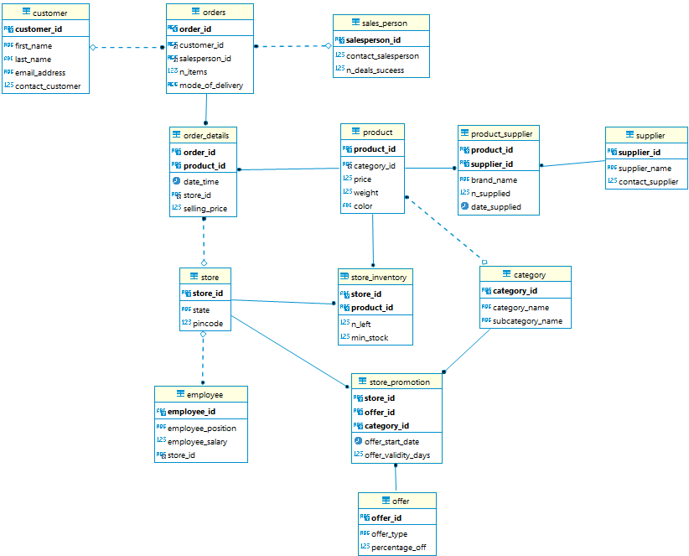

Slide 10
Explanations

Slide 11
Entity Explanation
Customer Entity
customer_id
first_name, last_name
email_address, phone_number
Orders Entity
order_id
n_items
mode_of_delivery
customer_id, salesperson_id
Order_details Entity
order_id, product_id
date_time
store_id
selling_price
Sales_person
salesperson_id
contact_salesperson
n_deals_success
Product
product_id
price
weight, color
category_id
Product_Supplier
product_id, supplier_id
brand_name
n_supplied
date_supplied

Slide 12
Entity Explanation
Supplier
supplier_id
supplier_name
contact_supplier
Store
store_id
state
pincode
Category
category_id
category_name
subcategory_name
Employee
employee_id
employee_position
employee_salary
store_id
Store_Inventory
store_id
product_id
n_left
min_stock
Offers
offer_id
offer_type
percentage_off
Store_Promotions
store_id
offer_id
category_id
offer_validity_days
offer_start_date

Slide 13
04
Reports

Slide 14
Report 1: Sales analysis by store

Slide 15
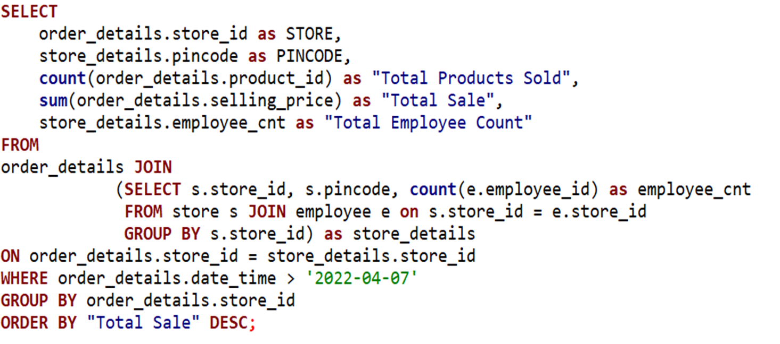
SQL Code:

Slide 16
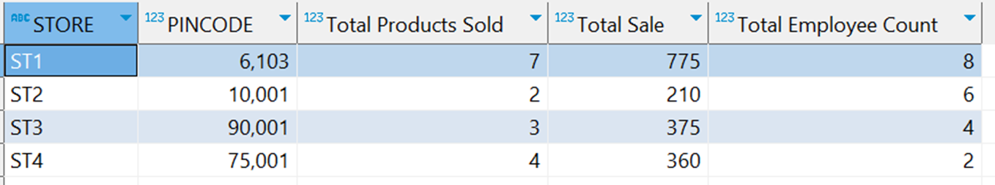
Business value:
(i)which store is generating the highest sales?
(ii) is the employee count at each of the stores affecting the sales?
Output:

Slide 17
Report 2: Customer purchase behavior patterns

Slide 18
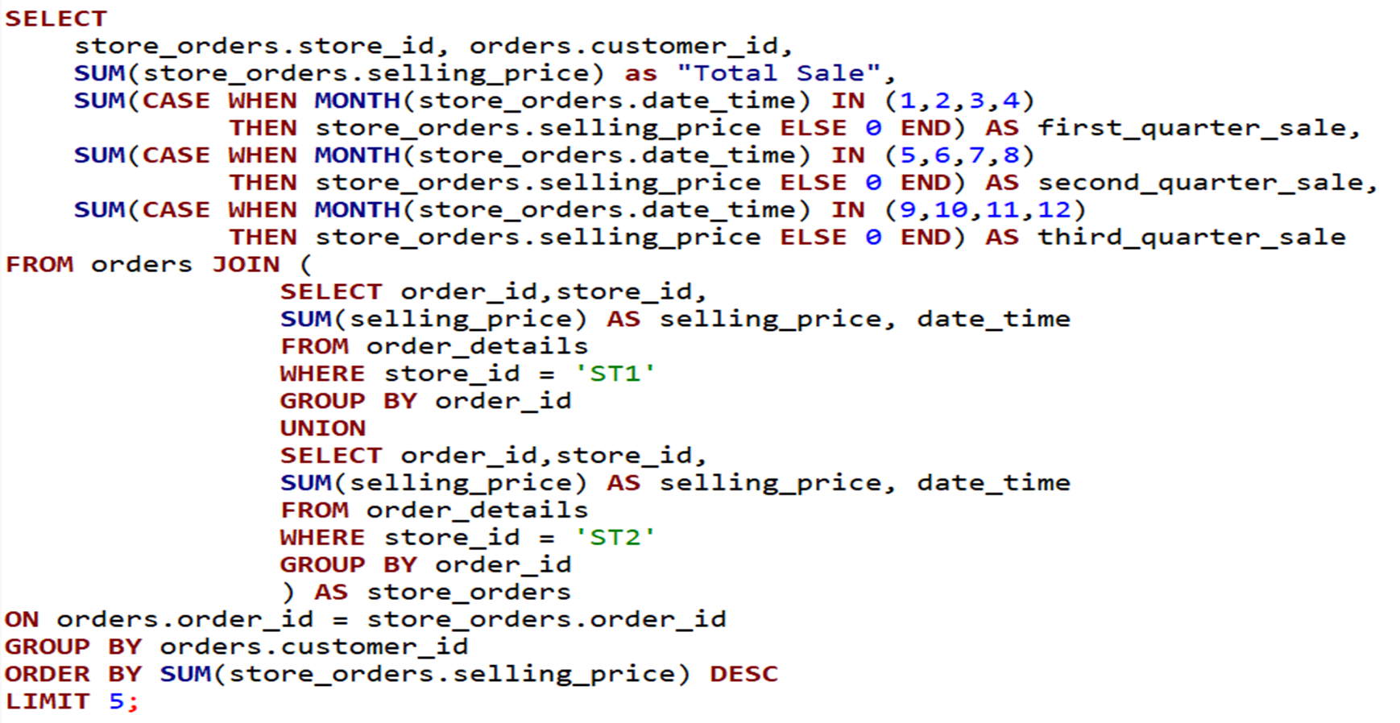
SQL Code:

Slide 19
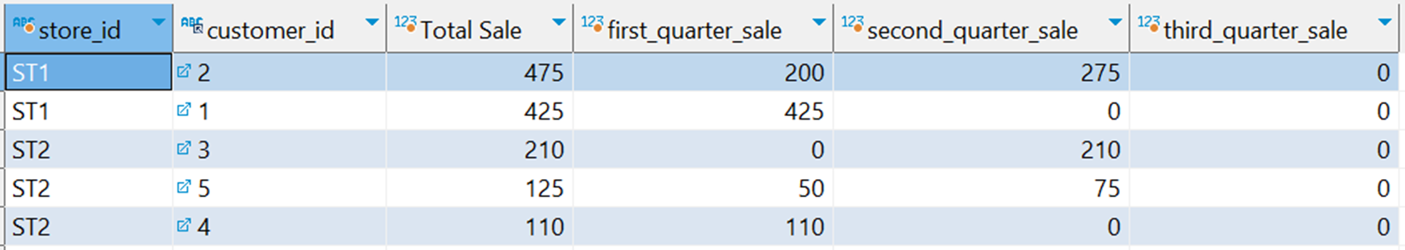
Business value:
(i) Is there a pattern in purchase behaviour of top customers in a year?
(ii) can business provide customized promotions to its valuable customers in particular season? (individual marketing decisions)
Output:

Slide 20
Report 3: Inventory management and tracking of product stock levels and reordering

Slide 21
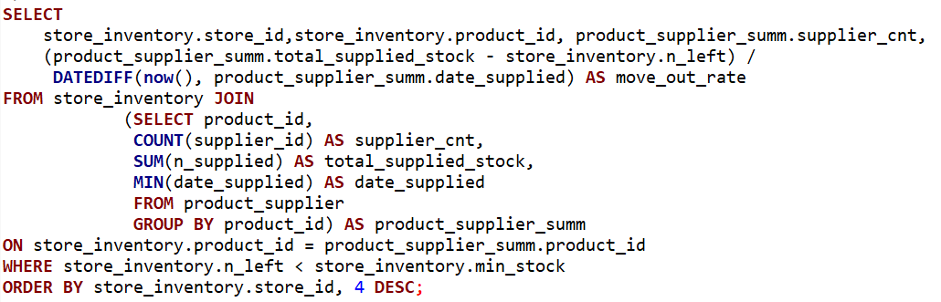
SQL Code:

Slide 22
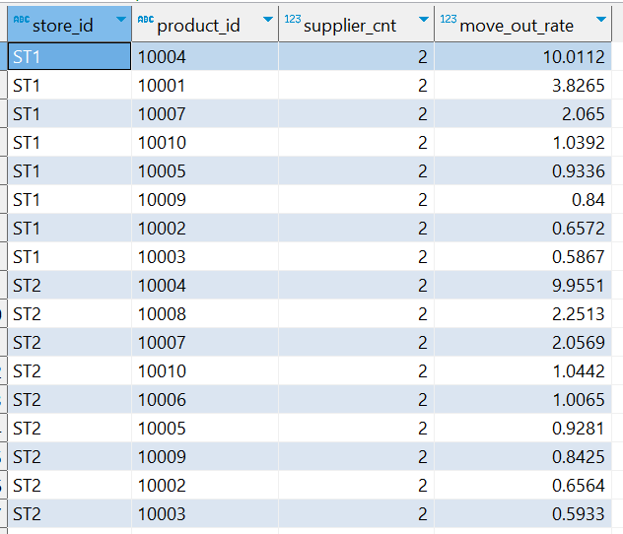
Output:
Business value:
(i) what products are currently out of stock
(ii) what is the move out rate of each of these products? which products are in high demand?
(iii) better inventory planning can reduce cost and lead to profits in long run

Slide 23
Report 4: Impact of promotions on sales

Slide 24
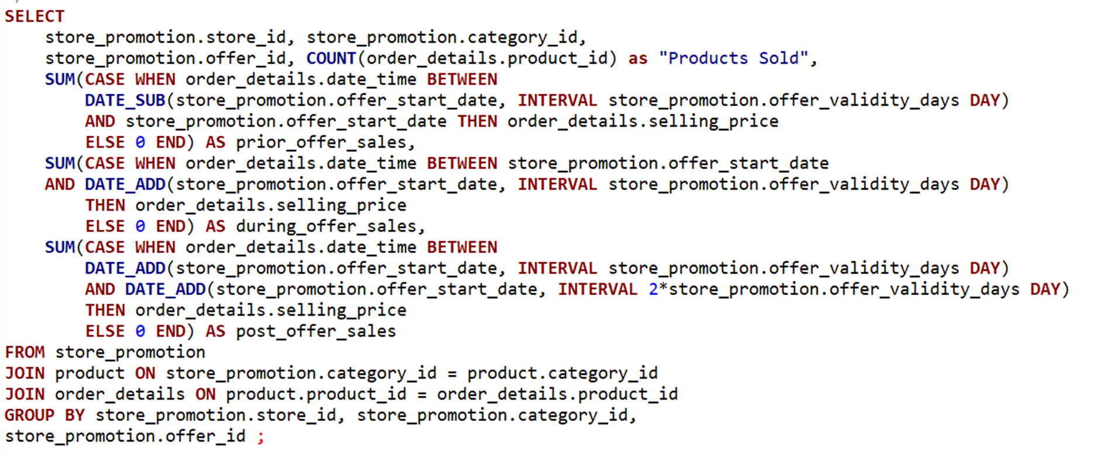
SQL Code:

Slide 25
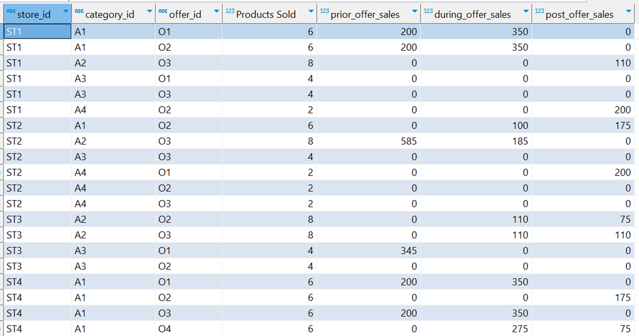
Business value:
(i) Is an offer more effective than other on a specific category and a store?
(ii) are there any offers that are not effective?
Output:

Slide 26
Report 5: Discount optimization for Short and Long Duration Offers by Category

Slide 27
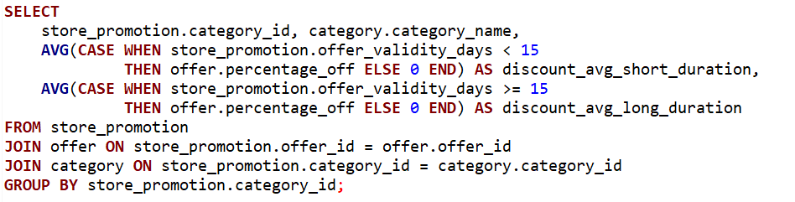
SQL Code:

Slide 28
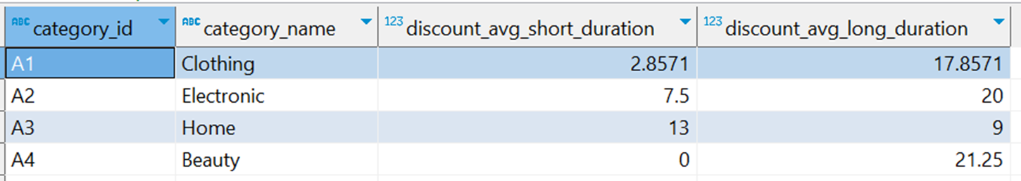
Business value:
(i) what are the optimal discount percentages of short and long duration offers per category?
(ii) can business adjust its discounts as per its competetors to maximize benefit?
Output:

Slide 29
05
Conclusion

Slide 30
Business Recommendations
Implement Predictive Analytics to forecast demand, identify trends, and optimize inventory levels. This will help the business make data-driven decisions and improve supply chain management.
Monitor Performance: Track key performance indicators (KPIs), such as sales, customer retention, and inventory turnover, using the system. This will help the business measure its progress and identify areas for improvement.

Slide 31
Thank You!
%

